Slide 1
Project Scheduling and Tracking
1

Slide 2
Introduction
Fred Brooks, the well-known author of The Mythical Man-Month , was once asked how software projects fall behind schedule. His response was as simple as it was profound:
"One day at a time."

Slide 3
Need of Scheduling & Tracking
Let’s say, as a project manager you have
  selected an appropriate process model,
  identified the software engineering tasks that have to be performed,
  estimated the amount of work and the number of people,
  knowledge of the deadline,
  considered the risks.
Now it’s time to connect the dots. That is, you have to create a network of software engineering tasks that will enable you to get the job done on time.
Once the network is created, you have to assign responsibility for each task, make sure it gets done, and adapt the network as risks become reality.
In a nutshell, that’s software project scheduling and tracking.

Slide 4
Who does it?
At the project level, software project managers using information solicited from software engineers.
At an individual level, software engineers themselves.

Slide 5
Why is scheduling important?
In order to build a complex system, many software engineering tasks occur in parallel, and the result of work performed during one task may have a profound effect on work to be conducted in another task.
These interdependencies are very difficult to understand without a schedule.
It’s also virtually impossible to assess progress on a moderate or large software project without a detailed schedule.

Slide 6
Scheduling in a Nutshell
Steps
  The software engineering tasks dictated by the software process model are refined for the functionality to be built.
  Effort and duration are allocated to each task and a task network (also called an “activity network”) is created in a manner that enables the software team to meet the delivery deadline established.
Work Product :
  The project schedule and related information are produced.

Slide 7
Scheduling Requirements
Proper scheduling requires that:
all tasks appear in the network,
effort and timing are intelligently allocated to each task,
interdependencies between tasks are properly indicated,
resources are allocated for the work to be done, and
closely spaced milestones are provided so that progress can be tracked.

Slide 8
Why Are Projects Late?
An unrealistic deadline established by someone outside the software development group
Changing customer requirements that are not reflected in schedule changes;
An honest underestimate of the amount of effort and/or the number of resources that will be required to do the job;
Predictable and/or unpredictable risks that were not considered when the project commenced;
Technical difficulties that could not have been foreseen in advance;
Human difficulties that could not have been foreseen in advance;
Miscommunication among project staff that results in delays;
A failure by project management to recognize that the project is falling behind schedule and a lack of action to correct the problem

Slide 9
Scheduling Principles
Compartmentalization—define distinct tasks
Interdependency—indicate task interrelationship
Time Allocation—define number of work units for each task.
Effort validation—be sure resources are available
Defined responsibilities—people must be assigned
Defined outcomes—each task must have an output
Defined milestones—review for quality

Slide 10
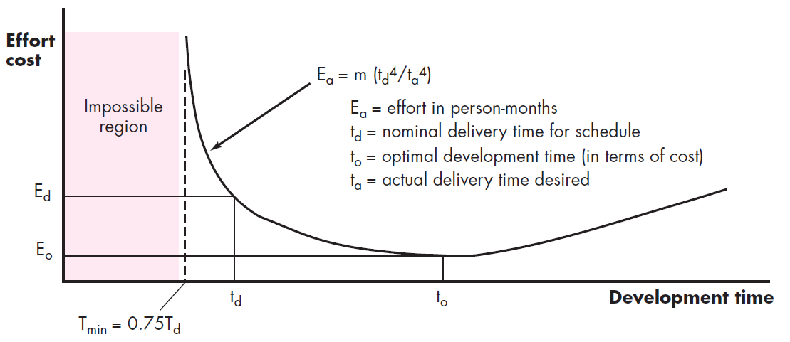
Effort and Delivery Time

Slide 11
Adding people in a late project
There is a common myth that is still believed by many managers who are responsible for software development projects: “If we fall behind schedule, we can always add more programmers and catch up later in the project.”
Unfortunately, adding people late in a project often has a disruptive effect on the project, causing schedules to slip even further.
The people who are added must learn the system, and the people who teach them are the same people who were doing the work.
While teaching, no work is done, and the project falls further behind
If you must add people to a late project, be sure that you’ve assigned them work that is highly compartmentalized.

Slide 12
Effort Allocation
“front end” activities
  customer communication
  analysis
  design
  review and modification
construction activities
  coding or code generation
testing and installation
  unit, integration
  white-box, black box
  regression
40-50%
15-20%
30-40%

Slide 13
DEFINING TASK SETS

Slide 14
Defining Task Sets
Determine type of project
Assess the degree of rigor required
Identify adaptation criteria
Select appropriate software engineering tasks

Slide 15
Type of Project
Concept development projects that are initiated to explore some new business concept or application of some new technology.
New application development projects that are undertaken as a consequence of a specific customer request.
Application enhancement projects that occur when existing software undergoes major modifications to function, performance, or interfaces that are observable by the end-user.
Application maintenance projects that correct, adapt, or extend existing software in ways that may not be immediately obvious to the end-user.
Reengineering projects that are undertaken with the intent of rebuilding an existing (legacy) system in whole or in part.

Slide 16
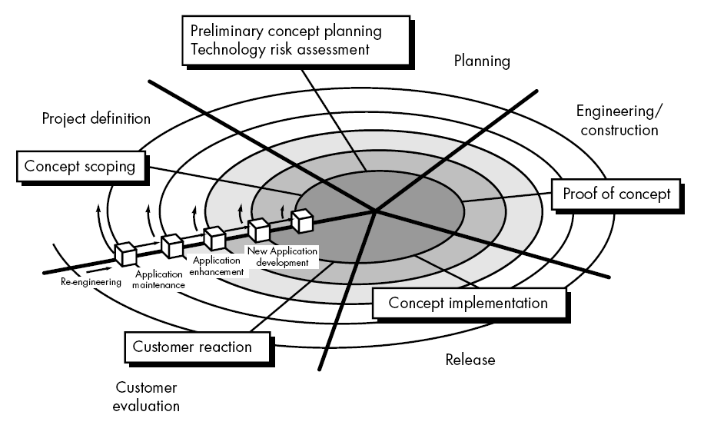
Development Task Using Evolutionary Model

Slide 17
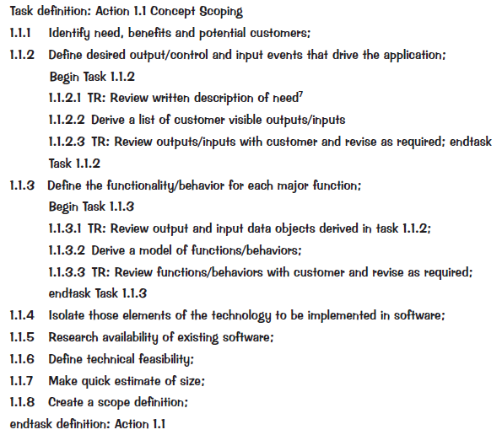
Task Set Refinement
1.1 Concept scoping determines the overall scope of the project.
is refined to

Slide 18
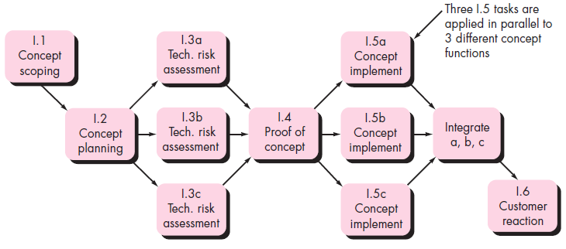
Sample Task Network

Slide 19
SCHEDULING

Slide 20
Software Project Scheduling Concepts
Generalized project scheduling tools and techniques can be applied with little modification for software projects.
Methods
  Program Evaluation and Review Technique (PERT)
  The Critical Path Method (CPM)
Both techniques are driven by information already developed in earlier project planning activities:
  estimates of effort,
  a decomposition of the product function,
  the selection of the appropriate process model and task set,
  and decomposition of the tasks that are selected.

Slide 21
Software Project Scheduling Concepts (contd.)
Interdependencies among tasks may be defined using a task network.
Tasks, sometimes called the project work breakdown structure (WBS), are defined for the product as a whole or for individual functions.
Both PERT and CPM provide quantitative tools that allow you to
  determine the critical path : the chain of tasks that determines the duration of the project,
  establish “most likely” time estimates for individual tasks by applying statistical models, and
  calculate “boundary times” that define a time “window” for a particular task.

Slide 22

History of CPM and PERT
Developed in 1950’s
CPM
  Developed by DuPont for chemical plants and the emphasis was on the trade-off between the cost of the project and its overall completion time (e.g. for certain activities it may be possible to decrease their completion times by spending more money - how does this affect the overall completion time of the project?)
PERT
  Developed by U.S. Navy for Polaris missile for the planning and control of the Polaris missile program and the emphasis was on completing the program in the shortest possible time. In addition PERT had the ability to cope with uncertain activity completion times (e.g. for a particular activity the most likely completion time is 4 weeks but it could be anywhere between 3 weeks and 8 weeks).

Slide 23
CPM - Critical Path Method
In CPM activities are shown as a network of precedence relationships using activity-on-node network construction
  Single estimate of activity time
  Deterministic activity times
USED IN : Production management - for the jobs of repetitive in nature where the activity time estimates can be predicted with considerable certainty due to the existence of past experience.

Slide 24
PERT
Definition: In PERT activities are shown as a network of precedence relationships using activity-on-arrow network construction
  Multiple time estimates
  Probabilistic activity times
USED IN : Project management - for non-repetitive jobs (research and development work), where the time and cost estimates tend to be quite uncertain. This technique uses probabilistic time estimates.

Slide 25
The Project Network
Use of nodes and arrows
Arrows ➔ An arrow leads from tail to head directionally
  Indicate ACTIVITY, a time consuming effort that is required to perform a part of the work.
  Nodes  A node is represented by a circle
  Indicate EVENT, a point in time where one or more activities start and/or finish.

Slide 26
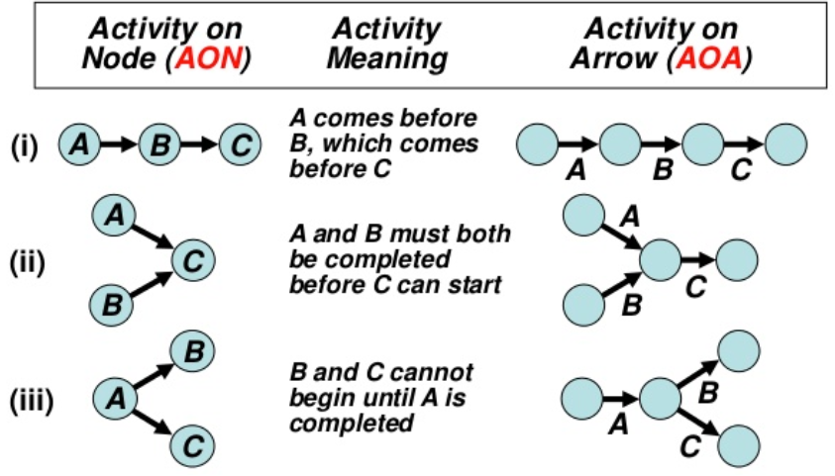
Activity on Node & Activity on Arrow

Slide 27
Activity Slack
Each event has two important times associated with it :
  Earliest time , T_{E} , which is a calendar time when a event can occur when all the predecessor events completed at the earliest possible times
  Latest time , T_{L} , which is the latest time the event can occur with out delaying the subsequent events and completion of project.
Difference between the latest time and the earliest time of an event is the slack time for that event
Positive slack : Slack is the amount of time an event can be delayed without delaying the project completion

Slide 28
Critical Path
Is that the sequence of activities and events where there is no “slack” i.e.. Zero slack
  Longest path through a network
  minimum project completion time

Slide 29
Benefits of CPM/PERT
Useful at many stages of project management
Mathematically simple
Give critical path and slack time
Provide project documentation
Useful in monitoring costs

Slide 30
Limitations to CPM/PERT
Clearly defined, independent and stable activities
Specified precedence relationships
Over emphasis on critical paths

Slide 31
Time Line Charts
When creating a software project schedule, you begin with a set of tasks (the work breakdown structure).
If automated tools are used, the work breakdown is input as a task network or task outline.
Effort, duration, and start date are then input for each task.
In addition, tasks may be assigned to specific individuals.
As a consequence of this input, a time-line chart, also called a Gantt chart, is generated.
  A time-line chart can be developed for the entire project.
  Alternatively, separate charts can be developed for each project function or for each individual working on the project.

Slide 32
Time Line Charts
Tasks
Week 1
Week 2
Week 3
Week 4
Week n
Task 1
Task 2
Task 3
Task 4
Task 5
Task 6
Task 7
Task 8
Task 9
Task 10
Task 11
Task 12

Slide 33
Time Line Charts
Advantages
  Gantt charts are quite commonly used.
  They provide an easy graphical representation of when activities (might) take place.
Limitations
  Do not clearly indicate details regarding the progress of activities
  Do not give a clear indication of interrelation ship between the separate activities

Slide 34
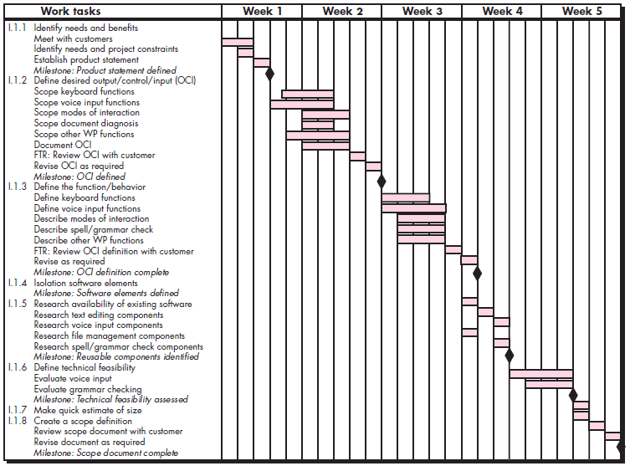
Timeline Chart Example : Using Automated Tools

Slide 35
TRACKING

Slide 36
Schedule Tracking
  Conduct periodic project status meetings in which each team member reports progress and problems.
  Evaluate the results of all reviews conducted throughout the software engineering process.
  Determine whether formal project milestones (the diamonds shown in Figure have been accomplished by the scheduled date.
  Compare actual start-date to planned start-date for each project task listed in the resource table.
  Meet informally with practitioners to obtain their subjective assessment of progress
  Use earned value analysis to assess progress quantitatively.

Slide 37
Earned Value Analysis (EVA)
Earned value
  is a measure of progress
  enables us to assess the “percent of completeness” of a project using quantitative analysis
  “provides accurate and reliable readings of performance from as early as 15 percent into the project.”

Slide 38
Computing Earned Value-I
The budgeted cost of work scheduled (BCWS) is determined for each work task represented in the schedule.
  BCWS_{i} is the effort planned for work task i.
  To determine progress at a given point along the project schedule, the value of BCWS is the sum of the BCWS_{i} values for all work tasks that should have been completed by that point in time on the project schedule.
The BCWS values for all work tasks are summed to derive the budget at completion, BAC. Hence,
BAC = ∑ (BCWS_{k}) for all tasks k

Slide 39
Computing Earned Value-II
Next, the value for budgeted cost of work performed (BCWP) is computed.
  The value for BCWP is the sum of the BCWS values for all work tasks that have actually been completed by a point in time on the project schedule.
The distinction between the BCWS and the BCWP is that the former represents the budget of the activities that were planned to be completed and the latter represents the budget of the activities that actually were completed.
Given values for BCWS, BAC, and BCWP, important progress indicators can be computed:
  Schedule performance index, SPI = BCWP/BCWS
  Schedule variance, SV = BCWP – BCWS
  SPI is an indication of the efficiency with which the project is utilizing scheduled resources.

Slide 40
Computing Earned Value-III
Percent scheduled for completion = BCWS/BAC
  provides an indication of the percentage of work that should have been completed by time t.
Percent complete = BCWP/BAC
  provides a quantitative indication of the percent of completeness of the project at a given point in time, t.
Actual cost of work performed, ACWP, is the sum of the effort actually expended on work tasks that have been completed by a point in time on the project schedule. It is then possible to compute
  Cost performance index, CPI = BCWP/ACWP
  Cost variance, CV = BCWP – ACWP

Slide 41
Progress on an OO Project-I
Technical milestone: OO analysis completed
    All classes and the class hierarchy have been defined and reviewed.
    Class attributes and operations associated with a class have been defined and reviewed.
    Class relationships have been established and reviewed.
    A behavioral model has been created and reviewed.
    Reusable classes have been noted.
Technical milestone: OO design completed
    The set of subsystems has been defined and reviewed.
    Classes are allocated to subsystems and reviewed.
    Task allocation has been established and reviewed.
    Responsibilities and collaborations have been identified.
    Attributes and operations have been designed and reviewed.
    The communication model has been created and reviewed.

Slide 42
Progress on an OO Project-II
Technical milestone: OO programming completed
    Each new class has been implemented in code from the design model.
    Extracted classes (from a reuse library) have been implemented.
    Prototype or increment has been built.
Technical milestone: OO testing
    The correctness and completeness of OO analysis and design models has been reviewed.
    A class-responsibility-collaboration network has been developed and reviewed.
    Test cases are designed and class-level tests have been conducted for each class.
    Test cases are designed and cluster testing is completed and the classes are integrated.
    System level tests have been completed.

Slide 43
End

